Slide 1

Capstone Project The Battle of Neighborhoods Exploring Ottawa
February 26, 2021
By Stanislav Kremenchutskyi

Slide 2

Introduction: Business Problem
Humans are always looking to make the right choices, especially, when it comes to big future-defining decisions. Being an immigrant myself, I’ve spent sleepless nights and long days weighting in our family’s choice to move to Canada. Eventually, I’ve met many people who were “in the same boat” and it turned out that we share a lot of common expectations, needs and that similar factors impact our final choice. That is why I chose to explore downtown Ottawa, Canadian Capital as a destination of choice to a lot of immigrants that I know. Setting aside such obvious factors as bilingualism of the area, convenient geographical location (Ottawa is almost equally distant from Toronto, Quebec City and New York, just some 4 hours drive!), I wanted to take a closer look at its social and economical aspect.

Slide 3

Introduction: Business Problem
My target audience are Eastern European people making their final choices between Canadian cities and towns. These people are usually couples or young families coming from big cities, they like to go out for lunch with friends, are well educated and know what they want from life. Also, newcomers prefer to settle in downtown areas which provide good transportation and access to most jobs and enable them to get the best feel of history and culture. Hence, in this project we will be looking at downtown Ottawa City Hall area.

Slide 4
Data
Based on definition of our problem, factors that will influence our decision are:
House price tendency for the past 20 years
Rental costs for the past 4 years for 1-, 2- and 3-bedroom accommodations
Number of restaurants in the area
Number of places of interest in the area
Number and variety of schools in the area

Slide 5
Data
Following data sources will be used to extract/generate the required information:
https://foursquare.com API for lists and geographical location of schools, restaurants and entertainment venues in Ottawa city center, data will be displayed on the maps and in tables
https://www.agentinottawa.com for accommodation purchase price tendencies for the past 20 years, data will be displayed on the plot
https://www.zumper.com for accommodation rent costs dynamics since 2016, data will be displayed on the plot

Slide 6

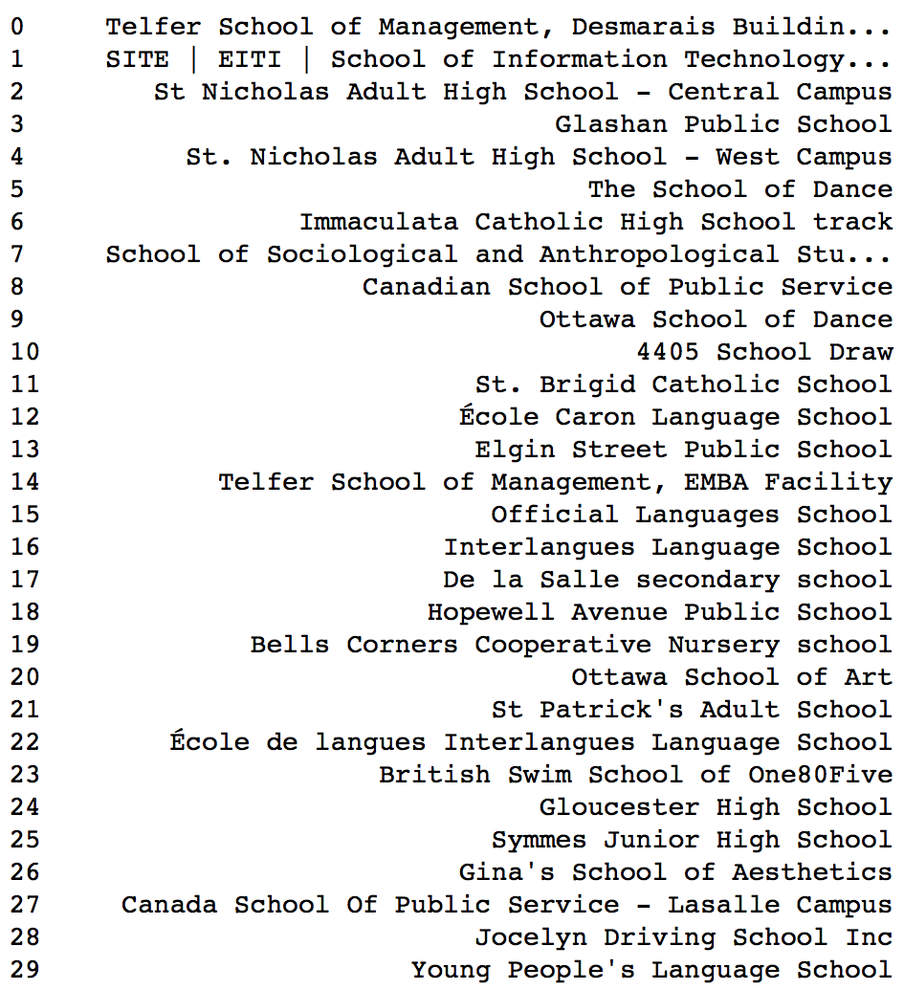
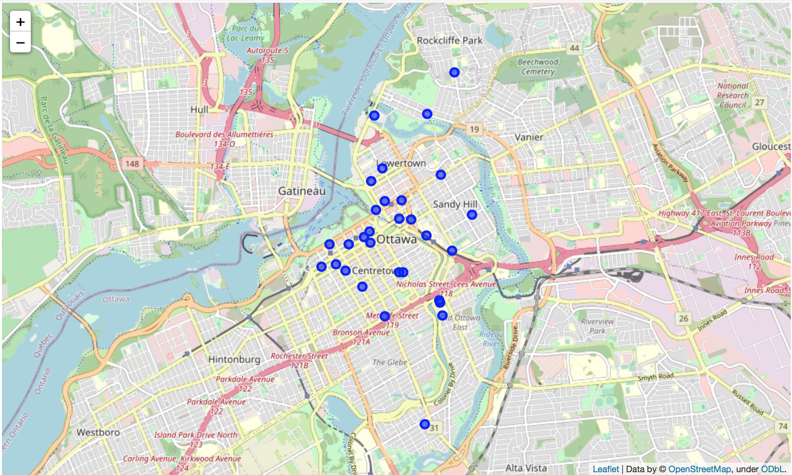
Neighbourhood Exploration
Schools in downtown

Slide 7
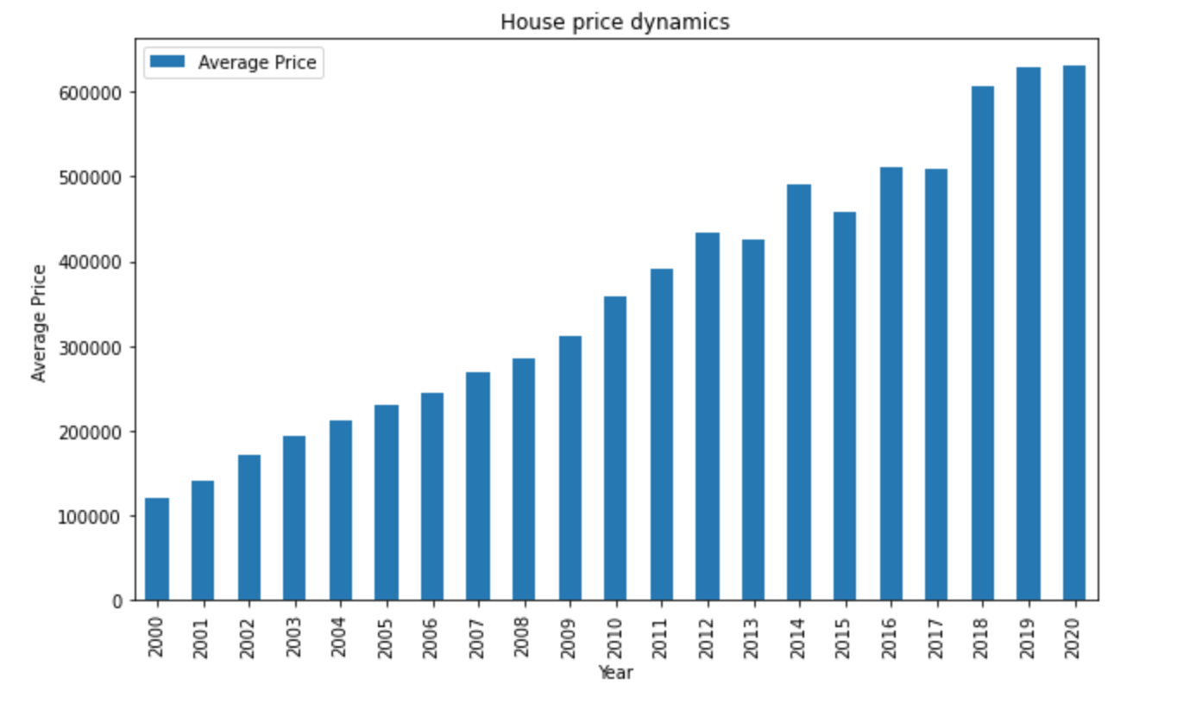
Neighbourhood Exploration
Average house prices in the past 20 years

Slide 8

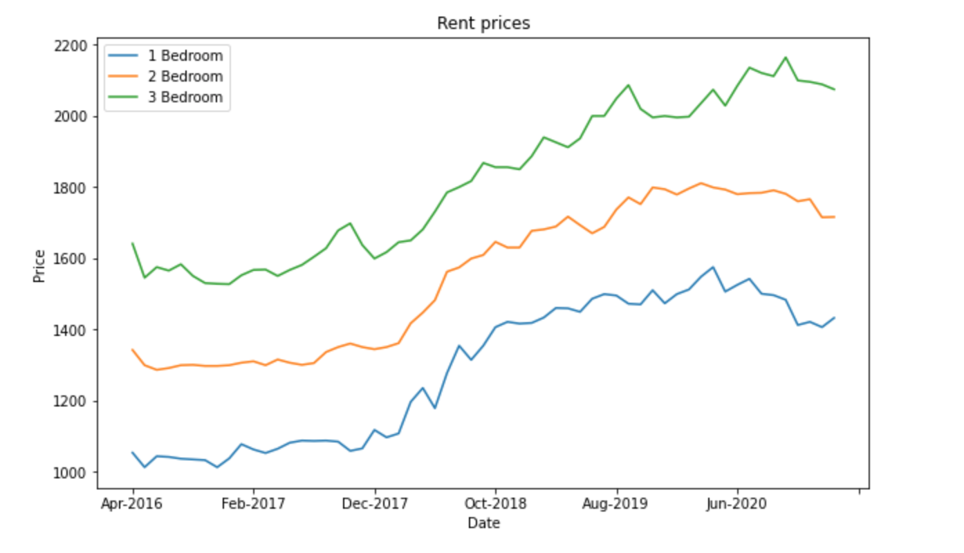
Neighbourhood Exploration
Average rental prices between 2016-2020

Slide 9
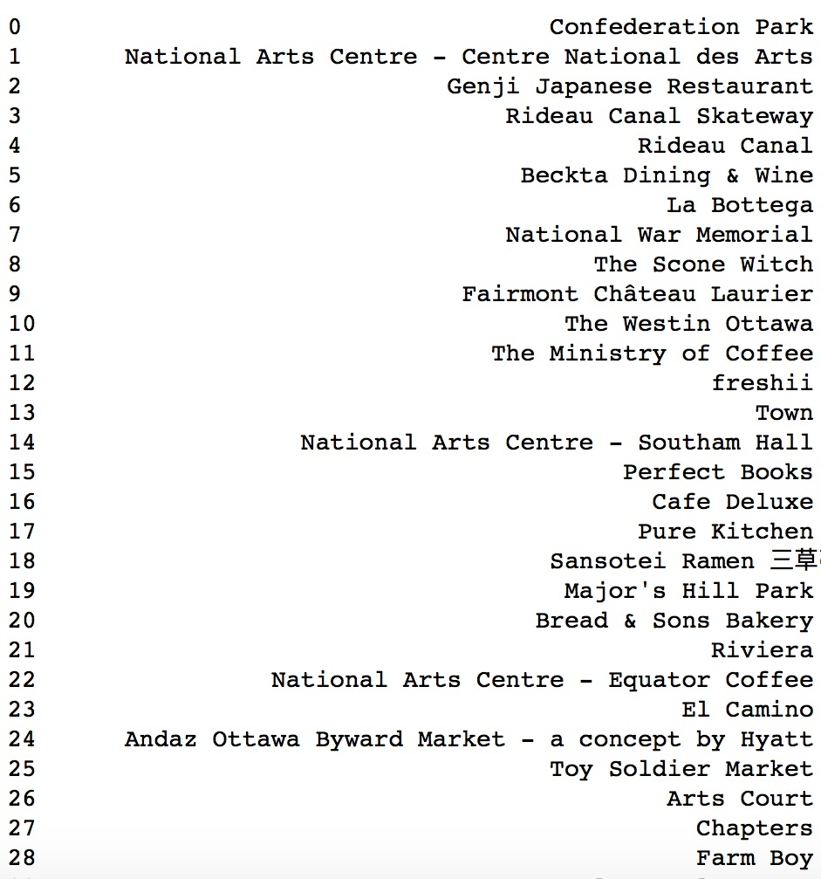
Neighbourhood Exploration
Different venues & entertainment available in downtown Ottawa

Slide 10
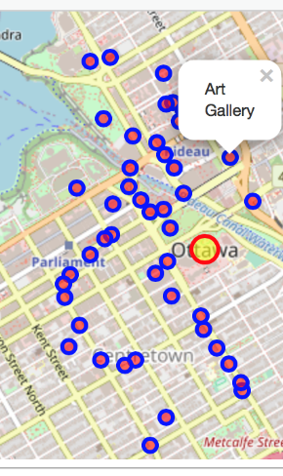
Neighbourhood Exploration
Different venues & entertainment available in downtown Ottawa

Slide 11
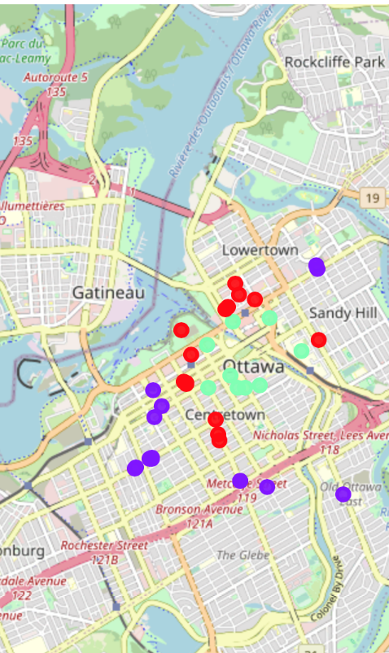
Neighbourhood Exploration
Restaurant density, 3km radius from downtown

Slide 12
Results
Now, it’s time to summarize and discuss the results. First, we found there are about 30 schools of different type within 3km city center radius. Next, we visualized the house purchase price dynamics between 2000-2020 and can see that average house price grew from about CAD 100,000 to CAD 600,000. We also looked at the accommodation rental pricing trends in the last couple of years (2016-2020) for 1-, 2-, and 3- bedroom boarding. Rental costs were steadily growing until the start of pandemic when price of a 3-bedroom boarding has declined, price of 2-bedroom has remained at the same level and price of 1-bedroom rent kept growing overall. Next, we analyzed venues and recreational options available in downtown. We limited result to a list of 50 assuming going out once a week could be enough for our newcomer and displayed it on the map. Also, similar process was done to downtown restaurants with visualizing them on the map and clustering them based on distance.

Slide 13
Conclusion
Summarizing our neighbourhood exploration effort, data we used from several sources, and the results we saw on graphs, we can say that overall Ottawa downtown is a perspective place to settle for young immigrants. Ottawa has a very smart investment opportunity for 1-bedroom housing, its downtown is filled with a variety of educational, cultural and entertaining activities for any taste and demand.

Slide 14
Thank you!

